Slide 1
Can we predict the price of shoes?
DSC 530 Final Project
Victoria Hall
11.20.2021

Slide 2
Hypothesis
Purpose – Determine what variables explain the price of shoes.
Hypothesis – Color and brand can help explain and predict the price of a shoe.
Dataset - https://www.kaggle.com/datafiniti/womens-shoes-prices

Slide 3
Variables
The variables
Why they were chosen
ID – The id number of the product that will appear.
Brand – This is the brand of the footwear product (IE Nike, Adidas, etc)
prices.isSale – renamed onsale. This is an indicator of whether or not the product was on sale when the price was recorded.
Prices.amountMin – renamed minprice. This is the lowest price of the product recorded for that instance in time.
Prices.amountMax – renamed maxprice. This is the highest price of the product recorded for that instance in time.
prices.currency – renamed currency. This is the currency (USD) the product was sold under.
prices.color - renamed color. The color of the product.
AvgPrice – This is the average price of that product in that particular instance. This was not included in the original dataset but is a transformation made that takes the min and max prices and finds the average.
ID – I chose to include a unique identifier for the cases just in case it becomes necessary to identify specific cases in the file
Brand - The point of this project is to see if we can predict the price of a product and the brand is a good indicator of the price of the product. This will be an independent variable in our analysis
On Sale – I chose this variable to see if there was an impact on price if the product was on sale.
Minprice – This is the minimum price that the product was observed at. This could be an independent variable to try and predict the price of the product though more than likely it will be transformed to use as the average price
Maxprice - This is the maximum price that the product was observed at. This could be an independent variable to try and predict the price of the product though more than likely it will be transformed to use as the average price.
Currency – I pulled this in to make sure that the currency was consistent across the product information. The value of currencies are different so I didn’t want this to impact the scale of the price. After transformations and edits to the dataset, all prices ended up being in USD.
Color – The color of the product could be a predictor of the price of the product assuming more popular colors would be higher priced.
AvgPrice – This is a transformation based off the min and max prices. Rather than trying to predict a minimum or maximum price, I decided to try and predict the average price.

Slide 4
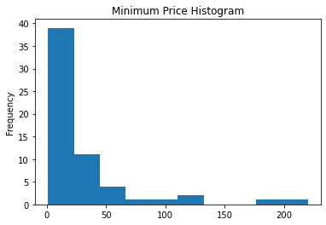
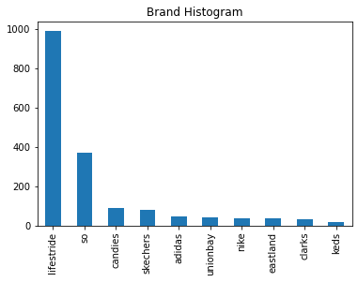
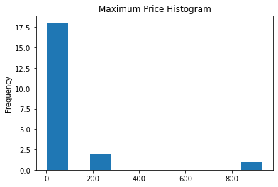
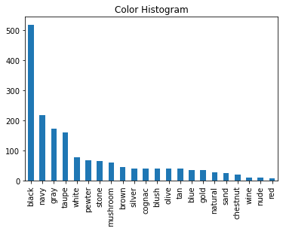
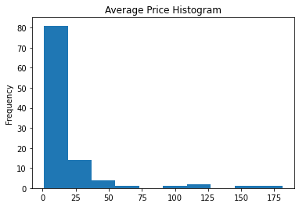
Histograms * Did not include histograms of currency and OnSale because after our transformations all the values were the same for those variables.
Overall Description:
In all instances we see slightly right skewed tails but overall I predict that once we remove major outliers the distribution will be relatively normal. In order to account for categorical data, I instead used the bar chart feature because the histogram option would only work for continuous data. In my min and max pricing, I am going to remove anything with a z score above 3 which means it is more than 3 standard deviations away from our mean so that the outliers don’t have undue weight on the data.
Observations:
The largest frequency of color is black which makes sense since most footwear includes a black colorway (*I work in footwear so this is domain knowledge I have).
Our min and max prices are distributed similarly but the range of the prices are different. In our min price, we see most product is between 0-$75 while our max price is between 0-$200. I will more than likely end up removing cases where the price is more than 2 – 3 standard deviations away to prevent overweighting these cases.
There is a lot of Lifestride product in our list which could mean our model will be overly reliant on Lifestride pricing as opposed to other brands.
*There were over 500 colors and 126 brands. Before making the histograms, I did some pre-work to only include colors with over 50 instances in the dataset and brands with over 10 instances in the data. I chose these numbers specifically s so that I would still have a substantial size dataset but also so the small instances wouldn’t have undue influence on the model. Also – the histograms were too busy with all instances of brand and color included.

Slide 5
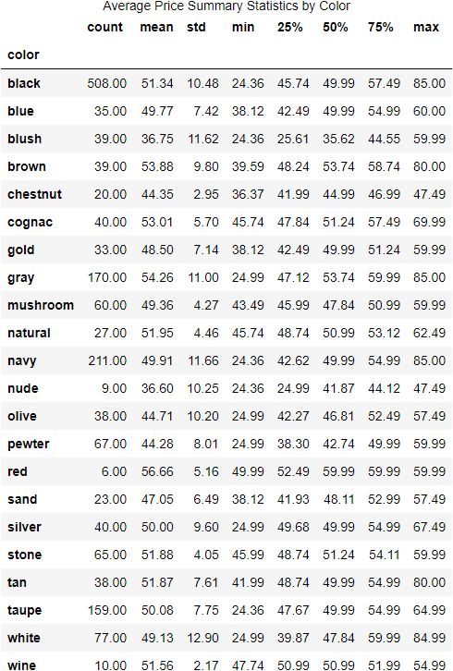
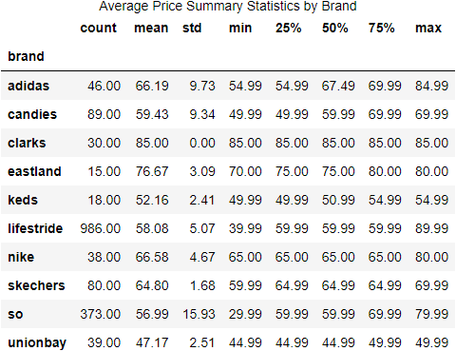
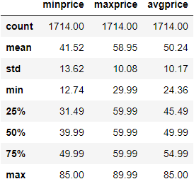
Summary Statistics – Numerical Data
Avg Price Median | Avg Price Mode
$49.99 | $59.99
Observations:
Mean price for all brands between 85 and 47 dollars.
Adidas and So prices are more widely distributed than the balance with larger SD from the means.
We have way more instances of black shoes and the Lifestride brand than any other.
Our mean median and mode are all within $10 of each other.

Slide 6
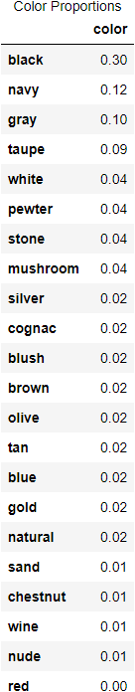
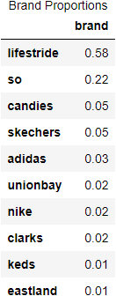
Summary Statistics Continued* Categorical Data
Brand “Mode” | Color “Mode”
Lifestride (986 cases) | Black (578 cases)
Callout:
As noted in our histogram slide, the color black and the brand Lifestride maybe overrepresented in our data.

Slide 7
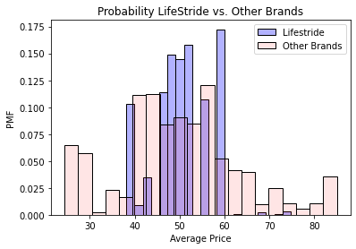
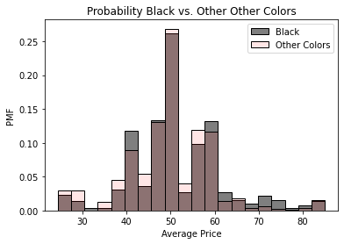
PMFs
Observations:
The first PMF graph compares the probability of an avg price for Lifestride compared to the rest of the brands. We see mostly overlap but It is much more likely for Lifestride product to be around $60 compared to the balance of the brands.
The second PMF graph compares the probability of the avg price for the color black versus the balance of the colors. These distributions appear much more similar than the brand differences. It does seem black is more likely to be expensive compared to the rest of the colors.
Additional Notes:
I chose to review this specific brand and color because they account for a large amount of the data in the dataset. I wanted to make sure the distribution of probability of average prices wasn’t grossly different for these compared to the balance of the data. Luckily the distributions appear to be relatively similar.

Slide 8
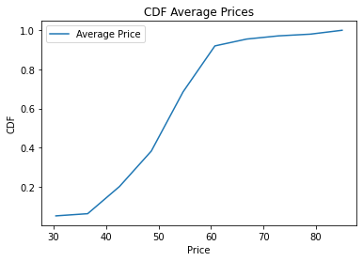
CDF
Observation:
Most prices are between $40-$60 dollars. 90% of cases fall between $30 and $60, and the remaining 10% are more sparsely distributed above $60. Again, we see a bit of a right winged skew but overall, this visual representation of our distribution confirms that there is distinct range of where prices fall that appears to be relatively normal.

Slide 9
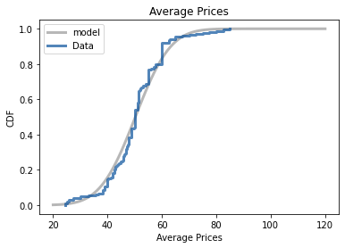
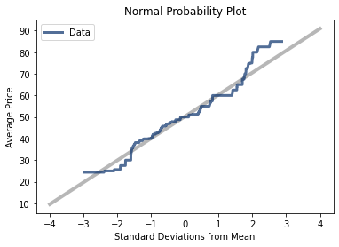
Analytical Distribution – The Normal Distribution
Observations:
With slight variance, the normal distribution appears to be a good model for the average price of shoes in our data.
We see a lot of overlap between the model of the normal distribution and of our data. At the top and bottom of our price range we see some movement that is abnormal but most of our data lines up with the normal distribution suggesting it is a good fit.
This also demonstrates a similar effect we saw in the CDF. Most of our data is centered around the mean price with $30-$60 range containing most of our data.
This is also reflective of the work done earlier to eliminate the impact of outliers because I removed cases where the outliers were more than three SDs from the mean.

Slide 10
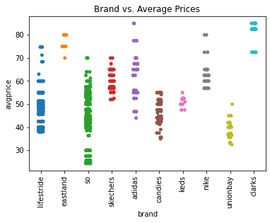
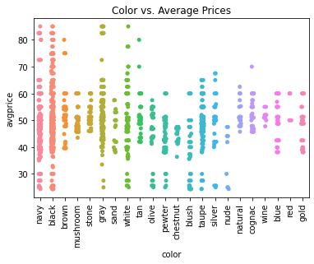
Scatter Plots
Observations:
We can see the range of average prices for each brand. Visually there does appear to be a relationship between the brands and the prices. For example, we see Clarks appear to be priced higher or So is priced mostly between $40-$60.
Colors appear to be more widely dispersed. There is a lot cases between the 40 and 60 range with some colors like navy and black going into higher price ranges. The relationship between color and price is less clear than brand.
It should be said that right now we are looking purely at correlation, that is to see if there is a relationship between the two variables. This is opposed to causation which mean been that brand or color is causing the price. We haven’t done enough analysis to show any sort of causation.

Slide 11
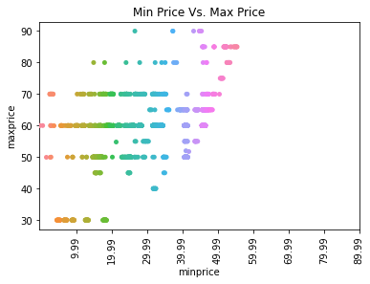
Covariance, Pearsons’s Correlation, Etc*
I could not perform these tests on the scatter plots in the previous slide because both color and brand are categorical. All of these tests rely on the mean of the data which I don’t have for the categorical data. I couldn’t use point biserial either because the categories aren’t binary. I also briefly considered using Cramers_V but that would require both variables to be categorical and prices are numeric.
In order to still show these tests I am going to look at the relationship between min and max prices even though it isn’t necessarily what I am looking to explain or predict in my overall model. I also looked at covariance in my code but chose not to include the array in the powerpoint because correlation tells us more than covariance.
Pearson’s Correlation Coefficient | P Value
.46 | 1.8071875812819447e-91
Spearman’s Correlation Coefficient | P Value
.36 | 2.8026267105688167e-52
There is a relatively strong relationship between the minimum and maximum prices and it is definitely statistically significant (our p value is extremely low).
There is also a positive relationship when we run Spearman’s that is also significant though I believe Pearson’s will suffice.

Slide 12
Hypothesis Testing
Black vs. Balance of Colors
Colors:
I used Student’s T Test to test my hypothesis that color can help predict the avg price of footwear. I chose to test the color black. Our null hypothesis is that the distributions of prices for black footwear is the same as the distribution of the other colors. This test is based on the assumption that this data has a Gaussian distribution which we saw earlier that these distributions are close to that. I was able to reject the null hypothesis because there was a significant difference in means with a P Value < .05. Just to note, my overall hypothesis is not that the color black explains price but color in general does. However, we can generalize that color has an impact in some way. A more robust test would run T Tests of all the colors. Once we run our model and evaluate it, we will be able to see more clearly if color is an impactful explanatory variable.
Student’s T | P Value
2.93 | .004
Lifestride vs. Other Brands
Student’s T | P Value
1.00 | .317
Brands:
I also used Students T Test on brands. In this instance our null hypothesis is that the distribution of average prices is the same for Lifestride as it is for other brands. After running the test I was unable to reject the null hypothesis. The difference in means was insignificant. My overall hypothesis is that brand can explain the price of the product but in this instance we did not see that. So, I decided to test on a couple other brands. In those instances, we were able to reject the null hypothesis. This shows brand does have an impact in some way however Lifestride has an extremely similar distribution to the whole sample. This in part could be explained by the fact that Lifestride is overrepresented in our data which is skewing the distribution. Once we run our model we should be able to see more clearly the impact of brand.
So vs. Other Brands
Student’s T | P Value
-15.61 | < .05*
* P Value was well below .05 so I didn’t list out the actual value

Slide 13
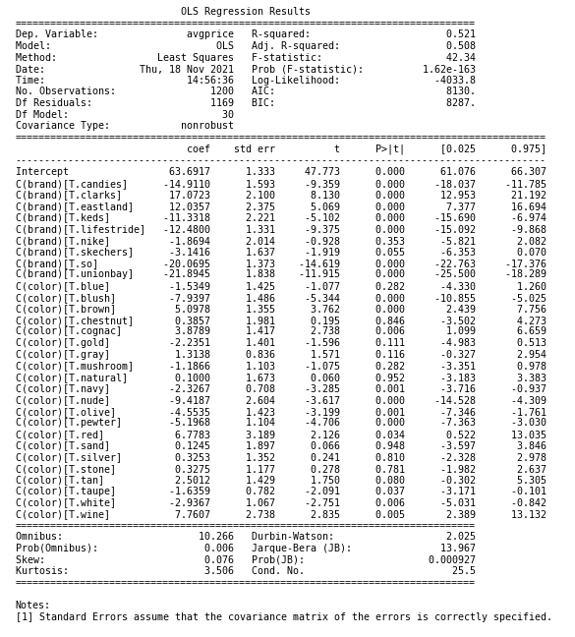
OLS Regression Model
Interpretation and Observations:
Brand has a much larger impact overall on the model than color. You can see this in the coefficients where brand ranges from -21.89-17.0723
Our R2 and Adj. R2 are .521 and .508 respectively. This means our model is accounting for around 50% of the variation in average prices. This means that there is something else (or multiple things) accounting for the other half of the variance.
Our Dubin Watson stat is 2.025 suggesting there is very little autocorrelation in our data.
Our Kurtosis value is 3.5 while a normal distribution is 3. Our skew is very minimal and suggests that the data is modeled similar to a normal distribution.
Most of our T Statistics deviate from 0 showing that are parameters truly aren’t actually 0.
The probability of our F Statistic is extremely low meaning that we can reject the null hypothesis.
Our standard errors are all between 1 and 2 dollars.
Accuracy on Test Data:
15% of predicted prices were within $1 of the actual price in the test set
57% of predicted prices were within $5 of the actual price in the test dataset.
85% of predicted prices were within $10 of the actual prices in the test dataset.
Additional Notes:
1. I used an ordinary least squares regression model because our data appeared to be generally normally distributed and there appeared to be a linear relationship.
2. I trained the model on 70% of the dataset and then tested it on the other 30%

Slide 14
Conclusions
While our model was able to account for around 50% of the variation in prices and accurately predict the price within $10 of the actual price for 85% of our test data, I would be remiss to say that this evaluation extends to the total population of footwear prices. There is another 50% of the variation that we couldn’t explain and our data was extremely limited compared to the whole population. We might more accurately be able to predict the prices of those specific brands we used. Color was less useful but still offered some predictive power. Overall we can say that color and brand do seem to impact prices but to what degree for the total population would require more research.

